Slide 1











Slide 2





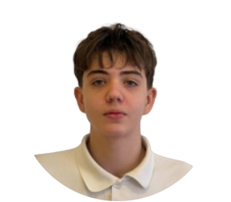
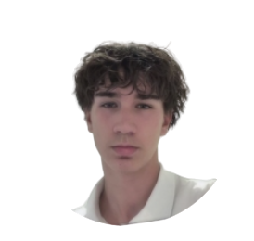
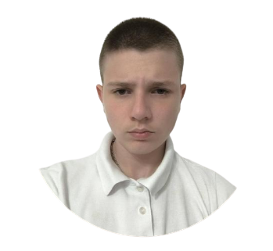

Our Team
Presyan Tenev
Alexander Dyanov
Vilian Ivanov

Slide 3




Why do most people quit?
No Motivation
Inconsistency
No Engagement
Generic apps offer no reward for effort. Users lose interest and drop off fast.
Without daily structure or streaks, people skip days and eventually stop.
Bland, lifeless interfaces feel like a chore — not something people choose.

Slide 4





StayFit makes it a game.
Daily Quests
Stars & XP
Ranks & Badges
AI Personalisation

Slide 5






Lets start the demo

